Slide 1
The Naked Functions programming model
See also: Getting started with Naked Functions

Slide 2
Quick links
Records
Main Menu actions
An action to retrieve one or more instances
An action to create and save a new instance
Actions contributed to an instance’s Action menu
View models
List of attributes, their roles, and applicability
Complementary functions - explanation
Validate, AutoComplete, Choices, Default, Disable, Hide
IContext helper methods
Today(), RandomSeed(), CurrentUser(), NewGuid()
(Advanced) Deferred functions

Slide 3
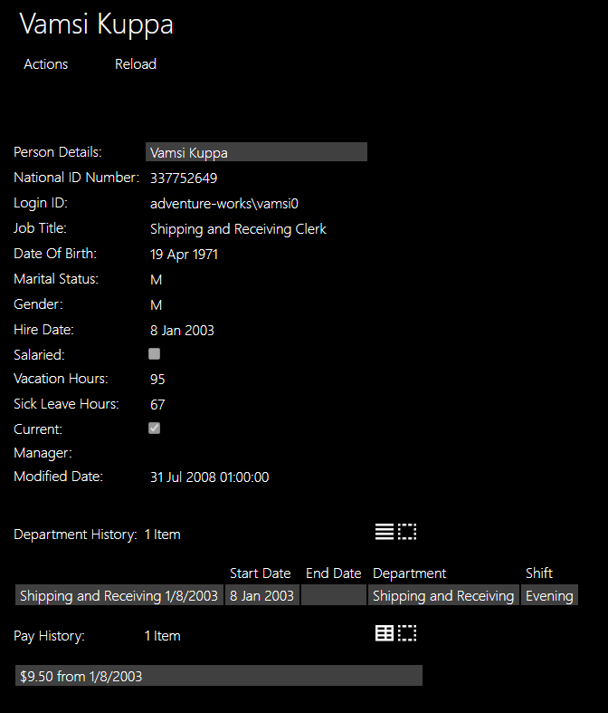
Most views are generated automatically from the underlying record
A record (in C# 9) is an immutable class. Properties have an init rather than a set, which means the property may only be set when constructing the object.
public record Employee
{
[Hidden]
public virtual int EmployeeID { get; init; }
[MemberOrder(1)]
public virtual Person PersonDetails { get; init; }
...
[MemberOrder(12)]
public virtual string JobTitle { get; init; }
...
[MemberOrder(16), Mask("d")]
public virtual DateTime? HireDate { get; init; }
...
[TableView(true,
nameof(EmployeeDepartmentHistory.StartDate),
nameof(EmployeeDepartmentHistory.EndDate),
nameof(EmployeeDepartmentHistory.Department),
nameof(EmployeeDepartmentHistory.Shift))]
public virtual ICollection<EmployeeDepartmentHistory> Depart
public override string ToString() => $"{PersonDetails}";
}

Slide 4
Each visible property is rendered as a field
public record Employee
{
[Hidden]
public virtual int EmployeeID { get; init; }
[MemberOrder(1)]
public virtual Person PersonDetails { get; init; }
...
[MemberOrder(12)]
public virtual string JobTitle { get; init; }
...
[MemberOrder(16), Mask("d")]
public virtual DateTime? HireDate { get; init; }
...
[TableView(true,
nameof(EmployeeDepartmentHistory.StartDate),
nameof(EmployeeDepartmentHistory.EndDate),
nameof(EmployeeDepartmentHistory.Department),
nameof(EmployeeDepartmentHistory.Shift))]
public virtual ICollection<EmployeeDepartmentHistory> Depart
public override string ToString() => $"{PersonDetails}";
}
4. [Hidden] tells the framework that this property is never displayed to the user
1. The property name is reformatted to provide the field label.
2. The optional MemberOrder attribute gives control over layout
3. Mask is one of several available attributes that give more control over formatting or other presentation behaviours.

Slide 5
If the property type is a domain type, it is rendered as a navigable link
public record Employee
{
[Hidden]
public virtual int EmployeeID { get; init; }
[MemberOrder(1)]
public virtual Person PersonDetails { get; init; }
...
[MemberOrder(12)]
public virtual string JobTitle { get; init; }
...
[MemberOrder(16), Mask("d")]
public virtual DateTime? HireDate { get; init; }
...
[TableView(true,
nameof(EmployeeDepartmentHistory.StartDate),
nameof(EmployeeDepartmentHistory.EndDate),
nameof(EmployeeDepartmentHistory.Department),
nameof(EmployeeDepartmentHistory.Shift))]
public virtual ICollection<EmployeeDepartmentHistory> Depart
public override string ToString() => $"{PersonDetails}";
}
The user may click on the link to view the associated object, or right-click to view it in the other half of the screen.

Slide 6
Collection properties are recognised and rendered as such
public record Employee
{
[Hidden]
public virtual int EmployeeID { get; init; }
[MemberOrder(1)]
public virtual Person PersonDetails { get; init; }
...
[MemberOrder(12)]
public virtual string JobTitle { get; init; }
...
[MemberOrder(16), Mask("d")]
public virtual DateTime? HireDate { get; init; }
...
[TableView(true,
nameof(EmployeeDepartmentHistory.StartDate),
nameof(EmployeeDepartmentHistory.EndDate),
nameof(EmployeeDepartmentHistory.Department),
nameof(EmployeeDepartmentHistory.Shift))]
public virtual ICollection<EmployeeDepartmentHistory> Depart
public override string ToString() => $"{PersonDetails}";
}
1. The user may open a view of any collection as a List or Table – by default showing all fields a columns.
2. The optional TableView attribute gives control over which columns are shown and in what order.

Slide 7
The view title is taken from the type’s ToString method
public record Employee
{
[Hidden]
public virtual int EmployeeID { get; init; }
[MemberOrder(1)]
public virtual Person PersonDetails { get; init; }
...
[MemberOrder(12)]
public virtual string JobTitle { get; init; }
...
[MemberOrder(16), Mask("d")]
public virtual DateTime? HireDate { get; init; }
...
[TableView(true,
nameof(EmployeeDepartmentHistory.StartDate),
nameof(EmployeeDepartmentHistory.EndDate),
nameof(EmployeeDepartmentHistory.Department),
nameof(EmployeeDepartmentHistory.Shift))]
public virtual ICollection<EmployeeDepartmentHistory> Depart
public override string ToString() => $"{PersonDetails}";
}
The title may be constructed from the values in multiple fields and/or from the title(s) of associated object(s) by using an interpolated string.

Slide 8
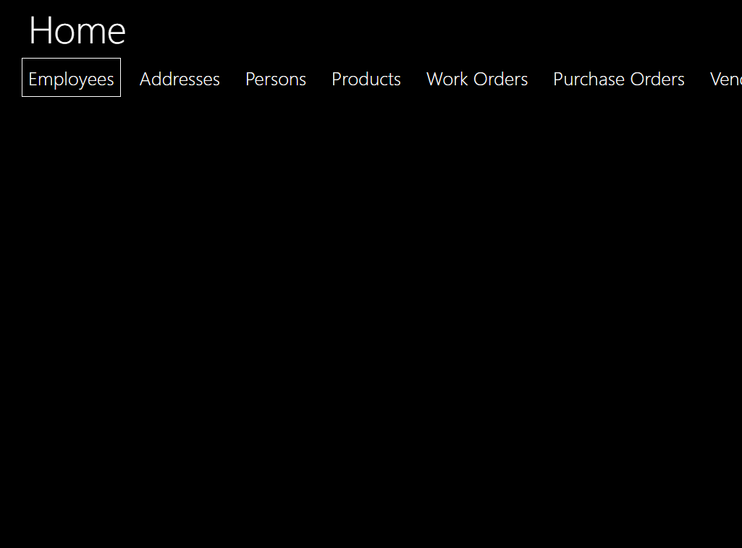
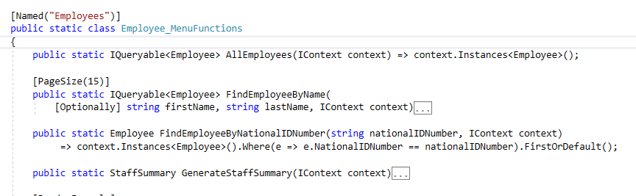
Main menus are specified by static classes
1. By default the menu name is a reformatted version of the class name, but this may be overridden with an optional Named attribute.

Slide 9
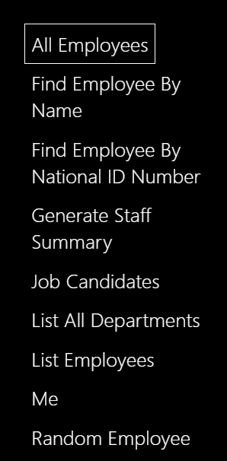
Each action on the open menu corresponds to a function on that type
1. The action name derived from the function name unless specified explicitly with another Named attribute.
3. If the returned type is IQueryable, the instances are automatically ‘paged’, and the default page size of 20 may be optionally overridden with a PageSize atttibute.
2. The return type, here, specifies what will be displayed to the user: either a single instance of a domain record type, or a collection of instances.

Slide 10
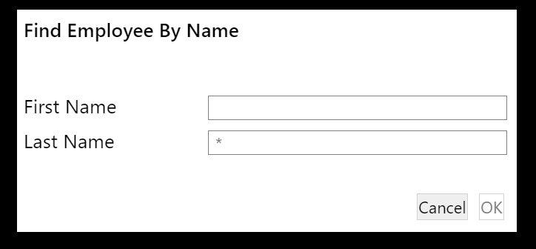
The dialog is derived directly from the function parameter list
1. The parameter name is used (reformatted) as a label, and the parameter type used to provide generic validation and/or other behaviour at the UI.
2. All parameters are made mandatory at the UI unless an Optionally attribute is added.

Slide 11
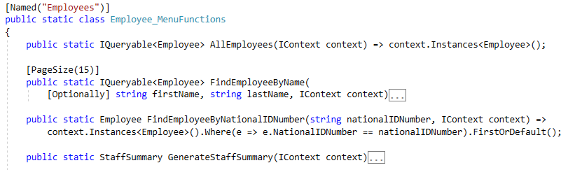
An IContext provides access to instances
1. An IContext parameter does not appear at the UI. If the function has no other parameters, then the menu action executes immediately, with no dialog.
2. The IContext provides access to an IQueryable of any domain type, to which LINQ may be applied.

Slide 12
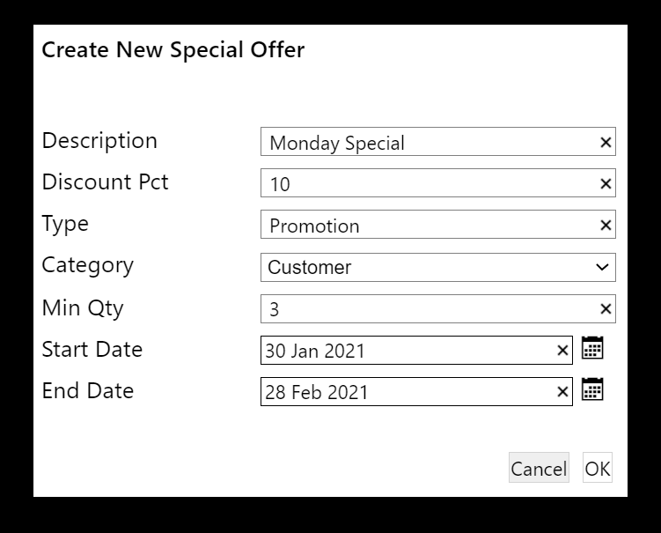
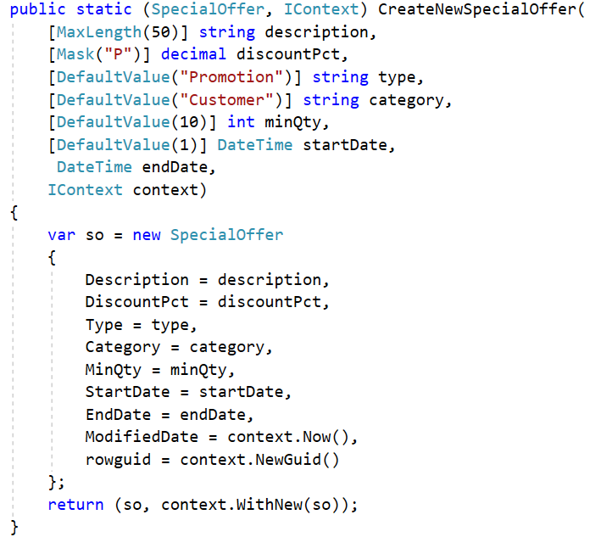
An action to create and save a new object…
1. The function returns a 2-tuple. The first item is the object (or collection) that will be displayed when the action has completed; the second is an IContext.
2. The function defines parameters for at least each of the mandatory properties of the new object, plus an IContext.
3. MaxLength, Mask, and DefaultValue specify behaviour of the generated dialog. For a DateTime parameter a date-picker (calendar icon) is automatically added and DefaultValue(n) means ‘n days after today’.
5. Important: CreateNewSpecialOffer is a pure function: it does not mutate the state of any object, nor of the external system. After this function has exited, the NakedFunctions framework reads the returned tuple, saves any new objects on the context to the database, and sends the same or other specified objects to the UI.
4. The returned context must be advised of all persistent objects that have been created. WithNew does not mutate the IContext: it returns a copy of the context with the new object(s) added.

Slide 13
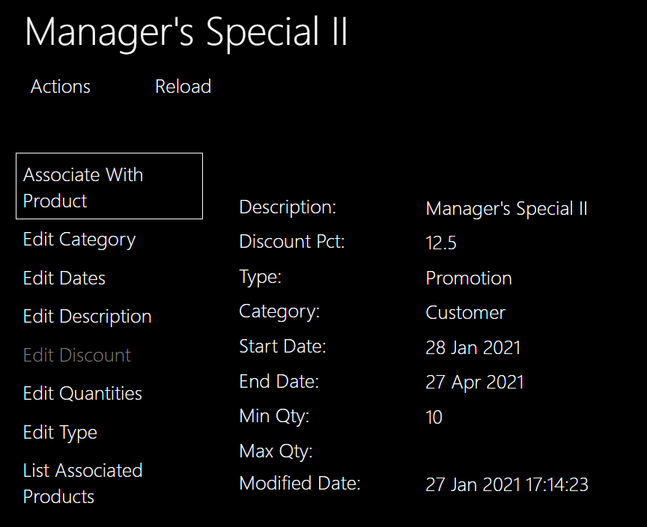
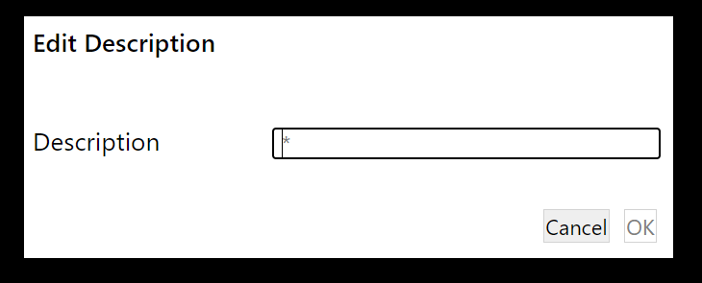
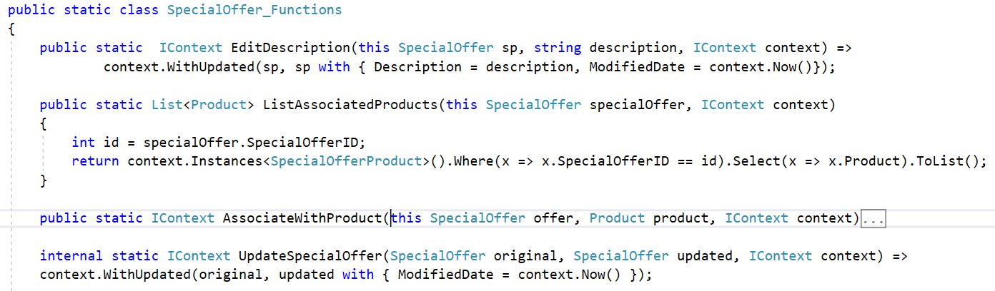
Actions contributed to an instance…
1. Displayed objects have their own Actions menu.
2. Any function using C# extension method syntax (this) is automatically contributed to the Actions menu of the type. Note that in the resulting dialog, the ‘this’ parameter is not rendered. When the user hits OK, the framework will call the corresponding function, providing the this parameter automatically (along with an IContext).
3. If the function does not require that the user is re-directed to a different object, then it may return just the context.
4. WithUpdated returns a new context with details of the updated object (before and after) added, for processing by the framework once the whole function has exited.
5. The with keyword creates a copy of the object, with just the differences specified in the following braces. In C# 9 with works only on records; from C# 10 it will work with classes also.

Slide 14
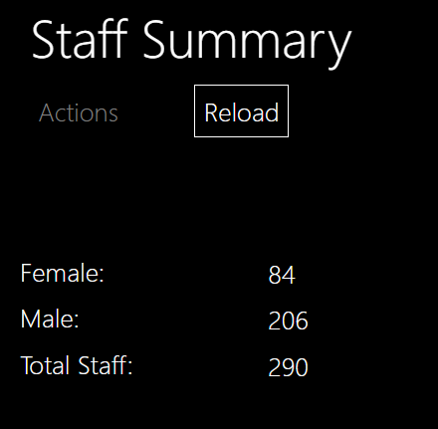
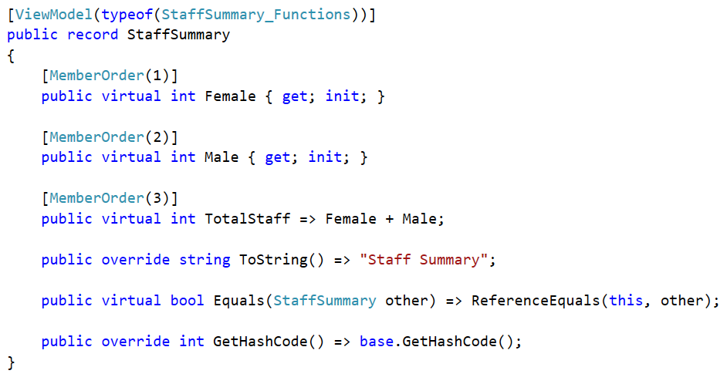
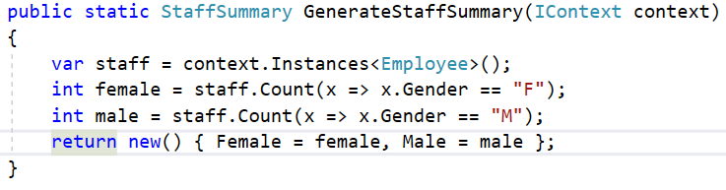
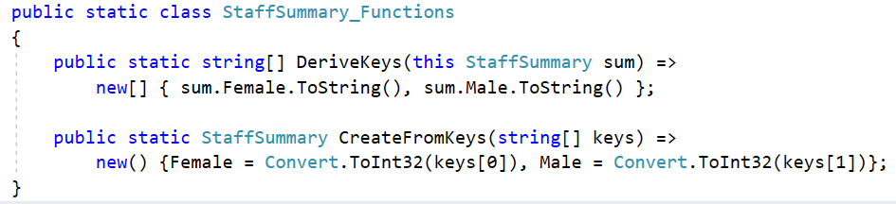
View Models…
1. A view model looks like any other object at the UI, but is not persisted in the database.
2. It is defined as an immutable record, like a persistent object, but is marked up with the ViewModel attribute, which specifies a type that contains the two functions DeriveKeys and CreateFromKeys for this specific type of view model.
3. A view model is created using the standard C# new syntax. The context is needed only to look up other objects if needed. (In this case the required type of StaffSummary is inferred from the function signature).

Slide 15
These attributes may be used to provide hints - to be interpreted and used by the Client. (Follow links to see example usage in code).
Attribute | On a Type | On a Property | On a Function | On a Parameter
[Bounded] | Indicates that the type has few instances, and these should be offered as drop-down choices for any parameter of that type.
[CreateNew] |  |  | Advises client that the instance returned as the first item in the tuple will be a new instance, so the function may be rendered in a way that makes this clear.
[DefaultValue] |  |  |  | Specifies default value for parameter. If used on a DateTime, an integer value indicates a day relative to today e.g. -1 = 'yesterday'.
[DescribedAs] | Specifies a (short) descriprition, or help, to be rendered as a 'tooltip' or 'placeholder' on the UI, according to the context.
[DisplayAsProperty] |  |  | Applied to a read-only object-contributed function that returns a value, reference, or collection, it will render the function, as a property on the type.
[Edit] |  |  | Advises client that the function creates a new instance and should be rendered accordingly.
[Hidden] |  | Indicates that a property should never be shown on the UI.
[Mask] |  | Formast the view of a value using standard Microsoft formats.
[MaxLength] |  |  |  | Specifies maximum accepted length for a string parameter.
[MemberOrder] |  | Specifies the relative order in which properties (including collections) should be displayed. The 'Grouping' property is currently unused on the client but is indicated on the RESTful API for possible custom use. | Specifies the relative order in which functions should be listed within a menu. The 'Grouping' property specifies a sub-menu (in which case the 'Order' property will specify ordering within that sub-menu).
Continued…

Slide 16
Attributes cont…
Attribute | On a Type | On a Property | On a Function | On a Parameter
[MinLength] |  |  |  | Specifies minumum accepted length for a string parameter. If used on the string parameter of an AutoComplete complementary function, specifies the minimum number of characters that must be typed before the auto-complete function will be engaged.
[MultiLine] |  | Specifies that a string property should be rendered as a multi-line text field, with specified number of lines, scrollable. The Width property is unused by the current client, but is exposed on the Resftul API for custom use. | Specifies that the user may invoke the corresponding action repeatedly - building up a table of entries. | Specifies that a string parameter should be rendered as a multi-line text field, with specified number of lines, scrollable. The Width property is unused by the current client, but is exposed on the Resftul API for custom use.
[Named] | Overrides the default name that would have been derived from the type/property/function/parameter name. Useful where, for example, the name presented to the user needs to include punctuation or symbols that cannot be used in a C# identifier.
[Optionally] |  |  |  | Specifies that the parameter is optional within a dialog. The client will not then render a '*' in the field, nor require an entry in the field before the user may click 'OK'.
[PageSize] |  |  | Used on a function that returns IQueryable<T> overrides the default page size (of 20 instances) for the rendered results. If used on an AutoComplete complementary function, species how many matching entries (max) will be offered to the user.
[Plural] | Overrides the default pluralised version of the type name e.g. for irregular nouns.
Continued…

Slide 17
Attributes cont…
Attribute | On a Type | On a Property | On a Function | On a Parameter
[PresentationHint] | Renders the specified string as an extension property on the corresponding representation in the RESTful API. For potential use in custom client views.
[RegEx] |  |  |  | A simple mechanism to validate the format of string parameters (see also Validate function)
[RenderEagerly] | Render all collection properties on the type, eagerly. | Specifies that a collection property should be automatically opened whenever an instance is displayed. | Used on a function that returns a collection, indicates that the result should be rendered in table view by default. (Usually used in addition to the TableView attribute.)
[TableView] |  | Specifies which columns of a returned collection should be rendered, when shown in table view. The first property (bool) indicates whether or not the title of the row instance should be included (as the first column).
[ValueRange] |  |  |  | Specifies the acceptable value range for and integer parameter. May also be used on a DateTime parameter to specify an acceptable range of days before (-) and/or after (+) today.
[Versioned] |  | Used to test that the user's view of an object is up to date before allowing a function that has side-effects may be invoked - effectively a 'long term' form of concurrency checking. Entity Framework's 'short term' form of concurrency check will also be needed. The two mechanisms may use the same field or different fields for their checks.
[ViewModel] | Specifies that a type is not persisted on the database but is a view model. The mandatory Type property must specify a type that contains the required static DeriveKeys and CreateFromKeys functions for the view model type.
Continued…

Slide 18
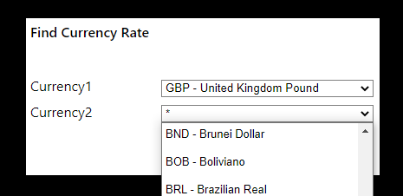
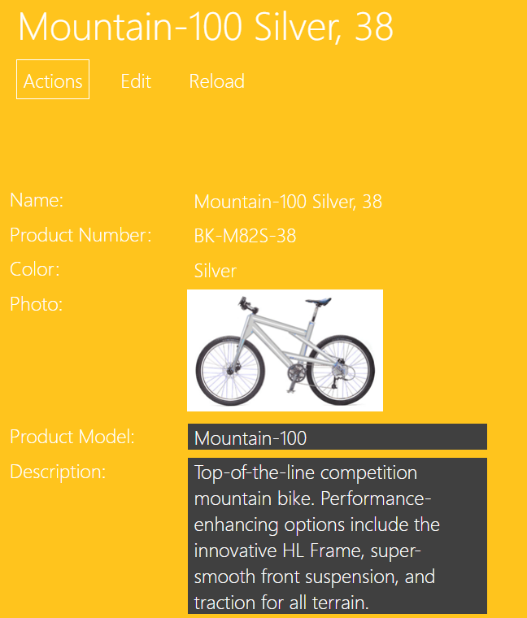
Some examples of using attributes
1. If a type is known to have a limited number of instances, it may be marked [Bounded]. Whenever this type is used as a parameter in a dialog, the user will be presented with all instances in a drop-down list.
[Bounded] public record Currency
[DisplayAsProperty, MemberOrder(11)]
public static ProductDescription Description(this Product product) =>
product.ProductModel is null ? null : ProductModel_Functions.LocalCultureDescription(product.ProductModel);
2. [DisplayAsProperty] will render a read-only function as a property on the type, at the UI.
Continued…

Slide 19
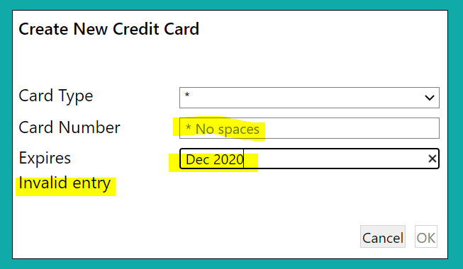
Some more examples of using attributes
public static IContext CreateNewCreditCard(this Person p,
string cardType,
[RegEx("^[0-9]{16}$")][DescribedAs("No spaces")] string cardNumber,
[RegEx("^[0-9]{2}/[0-9]{2}")][DescribedAs("mm/yy")] string expires,
IContext context) => …
1. [DescribedAs] provides user help. On a parameter the text will be displayed as a ‘placeholder’ in the empty dialog field; when applied to a function, the text will be rendered as a tooltip – seen when the mouse hovers over the corresponding action in a menu.
1. [RegEx] provides a convenient way to specify validation rules on string parameters.

Slide 20
‘Complementary functions’ define behaviour to be associated (by the framework) with another function
Validate one or more parameter values – using custom rules
See also [ValueRange], [MaxLength],[MinLength],[RegEx] attributes
AutoComplete a reference parameter
Present the user with Choices for a parameter value – using custom rules
See also [Bounded] attribute
Specify the Default value for a parameter – using custom rules
See also [DefaultValue] attribute
Disable an action based on specified conditions
Hide an action or property based on specified conditions
See also [Hidden] attribute

Slide 21
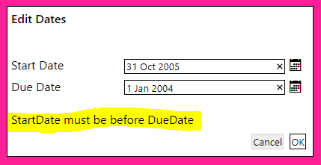
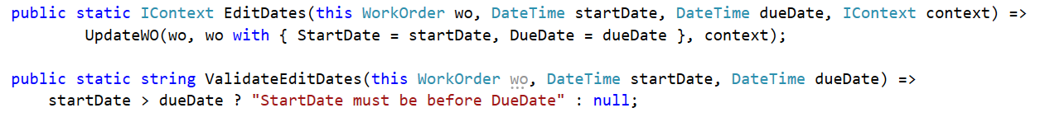
Validate one or more parameter values – using custom rules
1. This function ‘complements’ the EditDates function: it has the same name, with the Validate prefix. It will be called automatically by the framework when the user hits OK on the action dialog.
2. If the function returns null (or empty string), the EditDates function will be called with the dialog parameters. If a non-empty string is returned, EditDates will not be called, and the user will be presented with the validation message.
3. ValidateEditDates must take all the parameters of EditDates – same types and names (except for the IContext, which is optional). This permits ‘co-validation’. If desirable, individual parameters may have their own validation functions e.g. to validate just the startDate, the function would be named Validate1EditDates, and would take only the this parameter (the ‘contributee’) and the startDate parameter.

Slide 22
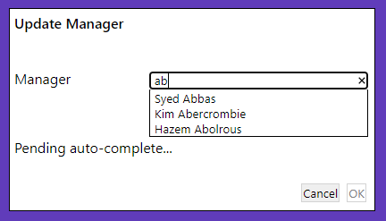
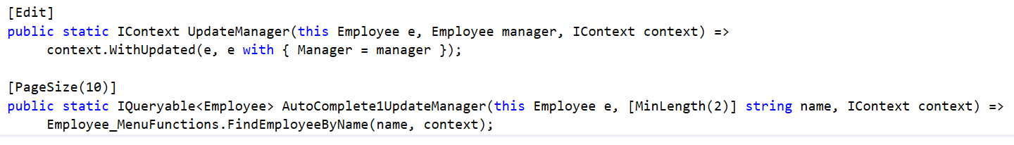
AutoComplete a reference parameter
1. Parameter 1 here requires an Employee object. The user may locate one separately and paste the reference into the dialog, but it is more convenient to just start typing the employee’s name and select from a list
2. The name of this function indicates that it provides auto-complete functionality for parameter 1 of the UpdateManager function. (Both functions must be defined on the same static class).
3. Specifies that no call will be made to the server until the user has typed at least 2 characters.
4. Specifies that only first 10 matches are offered to the user in the drop-down list
5. Here, the execution of the auto-complete function is delegated to an existing Find function used on the Employee menu.

Slide 23
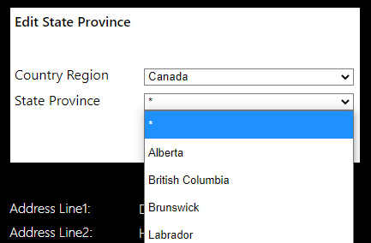
Present the user with choices for a parameter value – using custom rules
1. See also: [Bounded] attribute.
2. Choices for any parameter may be specified using a Choices complementary function, either creating instances as needed or filtering
public static IContext EditCategory(this SpecialOffer sp, string category, IContext context) =>
context.WithUpdated(sp, sp with { Category = category, ModifiedDate = context.Now() });
public static IList<string> Choices1Category(this SpecialOffer sp) => new[] { "Reseller", "Customer" };
public static IContext EditStateProvince(this Address a,
CountryRegion countryRegion, StateProvince stateProvince, IContext context) =>
UpdateAddress(a, a with { StateProvince = stateProvince }, context);
public static IList<StateProvince> Choices2EditStateProvince(this Address a,
CountryRegion countryRegion, IContext context) =>
StateProvincesForCountry(countryRegion, context);
3. Choices for one parameter may be made dependent on the value selected for another parameter. Here, the choices offered for parameter 2 (stateProvince) are based on the user’s selection of parameter 1 (countryRegion)

Slide 24
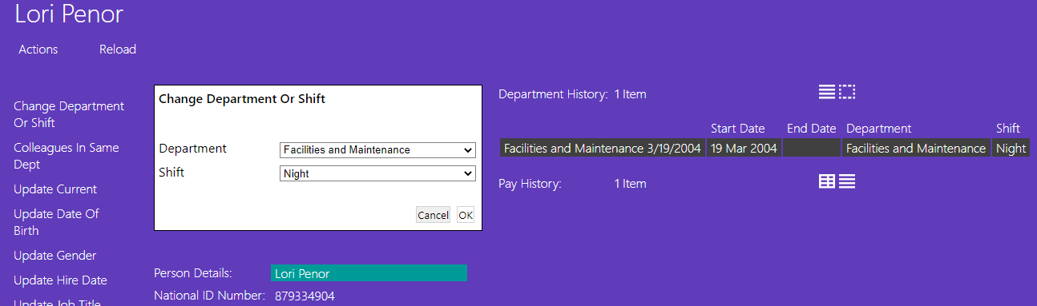
Specify the default value for a parameter - using custom rules
1. Here we want the default values (from the drop-down lists) to be the Employee’s existing Department and Shift
public static IContext ChangeDepartmentOrShift( this Employee e, Department department, Shift shift, IContext context) => …
public static Department Default1ChangeDepartmentOrShift(this Employee e) => CurrentAssignment(e)?.Department;
public static Shift Default2ChangeDepartmentOrShift(this Employee e) => CurrentAssignment(e)?.Shift;
private static EmployeeDepartmentHistory CurrentAssignment(Employee e) => e.DepartmentHistory.Where(n => n.EndDate == null).FirstOrDefault();
2. Default values are specified for parameters 1 & 2, derived from information in the Employee object

Slide 25
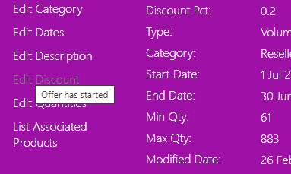
Disable an action based on specified conditions
public static IContext EditDiscount(this SpecialOffer sp, decimal discountPct, IContext context) => UpdateSpecialOffer(sp, sp with { DiscountPct = discountPct }, context);
public static string DisableEditDiscount(this SpecialOffer sp, IContext context) => context.Today() > sp.StartDate ? "Offer has started" : null;
1. We do not want the user to be able to alter the discount once the offer has started
2. A complementary Disable function is used. If this returns null (or an empty string) then the action is enabled. If not it is disabled, and greyed-out on the UI. The returned explanatory message will be rendered as a tooltip – shown if the user hovers on a disabled action.

Slide 26
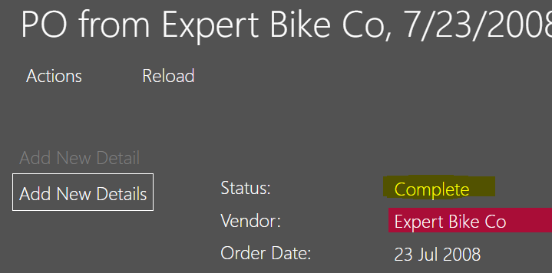
Hide an action or property based on specified conditions
1. The Approve action on a PurchaseOrderHeader should only be shown to the user while it is in a pending state.
public static IContext Approve(this PurchaseOrderHeader po, IContext context) => UpdatePOH(po, po with { Status = 2 }, context);
public static bool HideApprove(this PurchaseOrderHeader po) => !po.IsPending();
public static bool HideLoginID(Employee e, IContext context) { var userAsEmployee = Employee_MenuFunctions.CurrentUserAsEmployee(context); return userAsEmployee != null ? userAsEmployee.LoginID != e.LoginID : true; }
2. A complementary Hide function is used, which simply returns true or false.
3. A Hide function may also be used to hide a property on a type. This one hides the property named LoginID in an Employee, unless the logged on user is that employee.

Slide 27

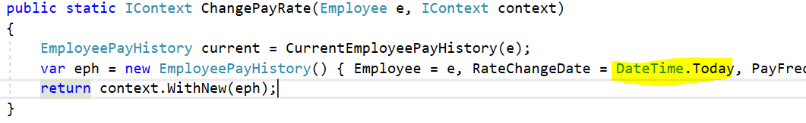
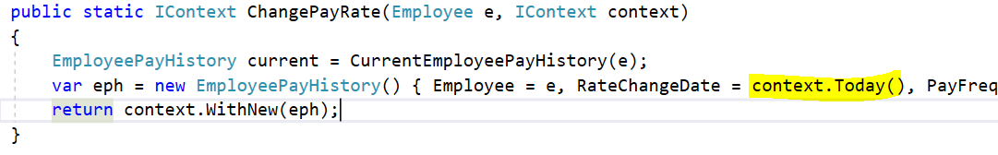
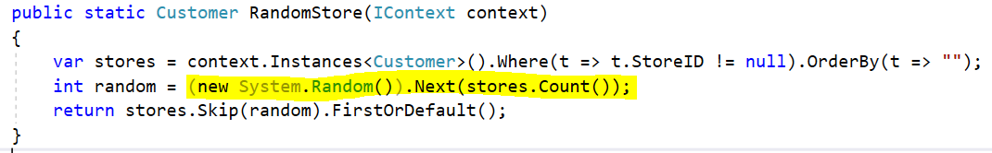
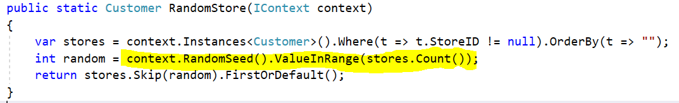
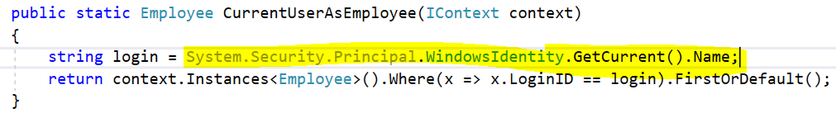
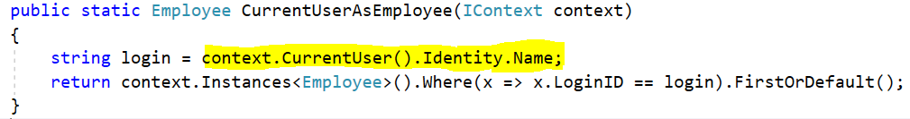
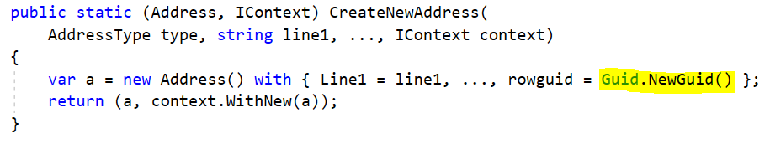
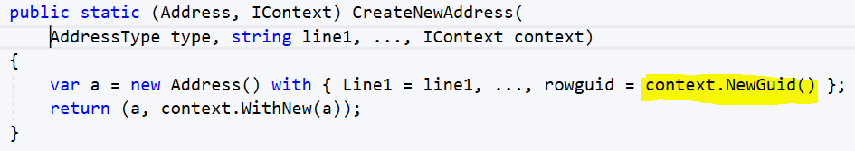
IContext provides helpers, so domain functions need never have direct dependencies, or impact, on System state (illegal in a pure function)
Continued…

Slide 28
These helper functions delegate to system services provided by the framework
The services are defined by interfaces:
IClock
IRandomSeedGenerator
IPrincipalProvider
IGuidGenerator
The default implementation of each service may be replaced with a custom implementation
This is especially useful in testing e.g. using a fixed, or programmable clock
Custom implementations are simply registered in the ConfigureServices method on StartUp.cs e.g.:

Slide 29
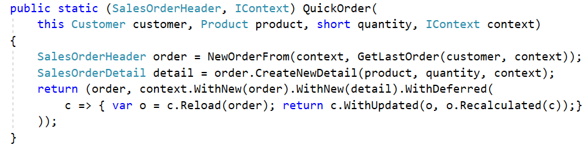
Advanced: A ‘deferred function’ is registered on the context, and will be executed by the framework only after the main function has exited and any changes have been saved to the database.
1. QuickOrder creates a new SalesOrderHeader and a new SalesOrderDetail object, both to be saved. The Recalculated function will update the order’s Total, but this will only work after the order and detail have been saved, and the detail appears in the order’s Details collection. Hence the recalculation is specified as a ‘deferred function’.
2. The deferred function is registered thus:
3. The deferred function is of type Func<IContext, IContext>. It may be defined as a lambda or a standalone function.
4. By defining it as a lambda, it can bind references from the scope of the original function, such the (sales) order, here. If that object will already have been updated by QuickOrder before the deferred function is called, then it should be reloaded before being used.
5. The deferred function may make further updates to any objects, or create and save new ones - by registering them on the returned context, for subsequent commitment by the framework.
Continued…

Slide 30
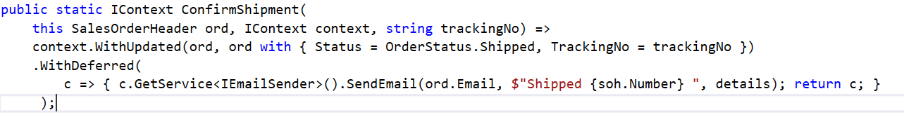
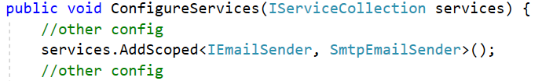
A deferred function may also generate side effects - without breaking the pure functional paradigm
1. ConfirmShipment updates the order, but also needs to send a confirmation email to the customer – which necessarily generates a side-effect.
2. The email is sent using a deferred function, which will be invoked by the framework only after ConfirmShipment has exited – so ConfirmShipment remains a pure side-effect-free function.
3. The context’s GetService method provides access to any system service…
… that has been registered in the ConfigureServices method on StartUp.cs in the Server project.

